Slide 1
Winner of the SIGSEGV 2023 Test of Time Award
Grant Storey

Slide 2
Introduction
Computer science is important.
Prior work has not solved a key problem.
We solve that key problem.

Slide 3
Related work
This paper perfectly organizes work in the area, summing up the prior generation of studies before making them obsolete.

Slide 4
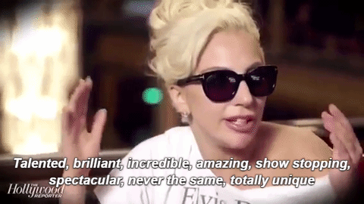
Methods

Slide 5
Results
Good

Slide 6
Results

Slide 7
Innovative Graph Techniques
Color Optimization
Generalized X-axification
Lines. Dots. Lines.

Slide 8
Conclusion
Truly a paper to remember.

Slide 9
QUESTIONS?

