Slide 1
Wavelength-Based Traffic Multiplexing on Avian Carriers
Edward Tremel – Cornell University
David Winkler – Cornell Lab of Ornithology

Slide 2
Motivation
Wink spends all day watching birds

Slide 3
Motivation
I spend all day watching packets

Slide 4
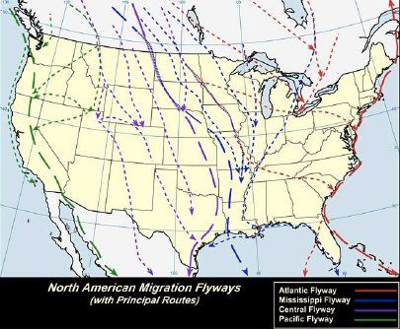
Can We Combine These Interests?

Slide 5
Prior Work

Slide 6
RFC 1149: IPoAC
Carry IP packets on pigeons
Problem: Pigeons are ugly and boring
Only one class of traffic
Likely to be blocked by modern pest control

Slide 7
Wavelength-Division Multiplexing
Fundamental technique in optical networking (IP over lasers)
Different classes of traffic carried by different colors of light
Allows single medium to be efficiently multiplexed

Slide 8
Our Design

Slide 9
Core Design Principles
Observation: There are many kinds of birds
Different sizes and colors
Scalability, multiplexing

Slide 10
Core Design Principles
Assign different traffic classes to different kinds of birds
Increase throughput while maintaining per-flow latency
Different flows sharing a common medium

Slide 11
Example: Social Networks
Social networking data: an important traffic class
All Social Networks are blue
Therefore blue is the best color for social network traffic

Slide 12
Social Networks: Blue Jays
Blue
High capacity
Loud
Announce their presence
Jumbo packet

Slide 13
High-Priority Traffic
Cardinals
Red = important
Year-round availability
Stay in couples
Redundancy, fault-tolerance

Slide 14
Streaming Media
Blackbird singing in the dead of night
Well-suited for carrying audio traffic

Slide 15
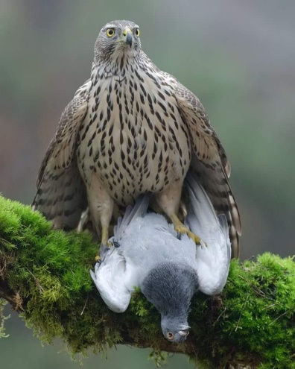
Packet Filters
Goshawks, sparrowhawks, and other accipters
Hunt and kill avian packets deemed to be unwanted
Malicious packet

Slide 16
Evaluation

Slide 17
Bandwidth vs. IPoAC
1
1
Blue Jays
Pigeons
Cardinals
Titmice
Cumulative Probability
0.75
Cumulative probability
0.75
Goldfinches
0.5
0.5
0.25
0.25
0
0
0
0.5
1
0.75
2
0
1
2
3
4
Bandwidth (kbps)
Bandwidth (kbps)

Slide 18
Network Congestion and Black Holes
Incast Problem (Flocking Behavior)
Routing Black Holes (Bird Feeders)

Slide 19
Questions?

