Slide 1
Dispatches from Unnatural Language Processing
A Neural Framework for Analyzing the Tweets of dril

Slide 2
Background: NLP
Natural Language Processing

Slide 3
Background: NLP
PL
Constructed Languages
NLP
???

Slide 4
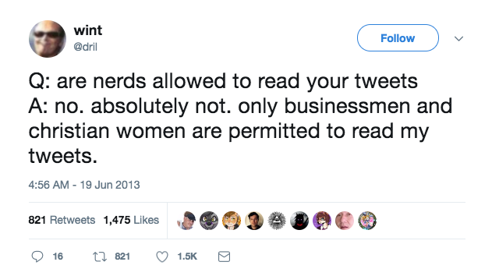
Our Problem: Dril’s Tweets

Slide 5
Problem: Dril’s Tweets
Incredibly valuable dataset of unnatural language.

Slide 6
Previous Work
Barbiere 2016, etc, on Emoji.
Parker 1999 on Cthulu’s “bellows”.
Yarini and Fubata 2002 on train conductor speech.
Johnson 2011 on frat bro heckling.

Slide 7
Data Set: Construction
Goals.
Mechanical-Turk interface.
Robust recruitment process.
Training.
Validity checks.

Slide 8
Data Set: Statistics
108 examples: 88 train/10 validate/10 test.
Cronbach’s α: .8009 (“good”).
Available online.

Slide 9
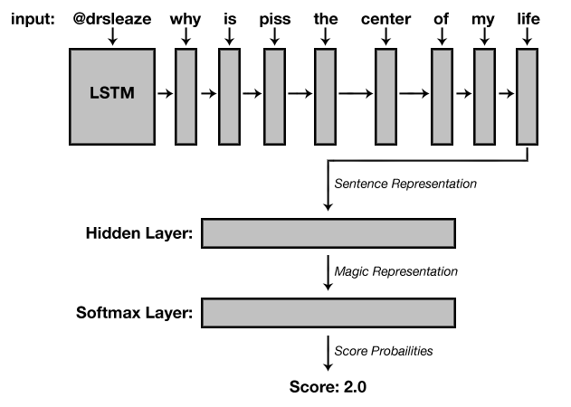
Method: Diagram

Slide 10
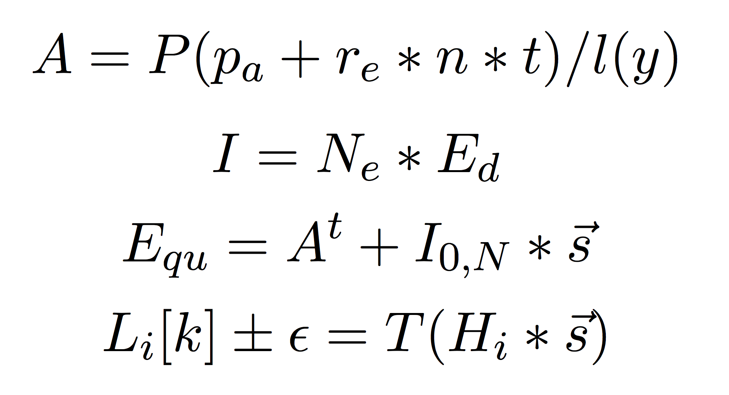
Method: Equations

Slide 11
Results
Model | Validation Acc | Test Accuracy
Majority-Class Baseline | 50% | 50%
Our Model
50%
30%

Slide 12
Discussion
Task Limitations.
Applications for saving humanity.
Wide class of similar problems.
Notes:
Why do kids love the taste of Cinnamon Toast Cruch?

Slide 13
Concluding Thoughts
dril saved humanity.
Elon Musk can sleep a little more soundly.

