Slide 1
Solidus
Blockchain
Ethan Cecchetti
March 26, 2017

Slide 2
Blockchains
Blockchain
Blockchain blockchain blockchain blockchain
Blockchain blockchain blockchain
Blockchain
Blockchain (blockchain)
Blockchain blockchain, blockchain blockchain blockchain
Blockchain blockchain blockchain.

Slide 3
Blockchain Blockchain – Bitcoin
Blockchain blockchain
A
G
blockchain blockchain
I
F
3.5
1
1.5
Blockchain, blockchain, blockchain
L
N
2.5
5
4
K
D
4
2
3
Blockchain
B
C
2
E
M
0.5
H
J

Slide 4
Blockchain Blockchain – Zcash
A
F
Blockchain blockchain blockchain
Blockchain!
G
N
L
I
B
E
D
M
Blockchain!
C
H
K
J
Blockchain blockchain
blockchain…
??
??
??
??
??
??
Blockchain blockchain blockchain!
??
??
??
??
??
??
…blockchain blockchain blockchain
??
??
??
??
??
??
??
??
??
??
??
??

Slide 5
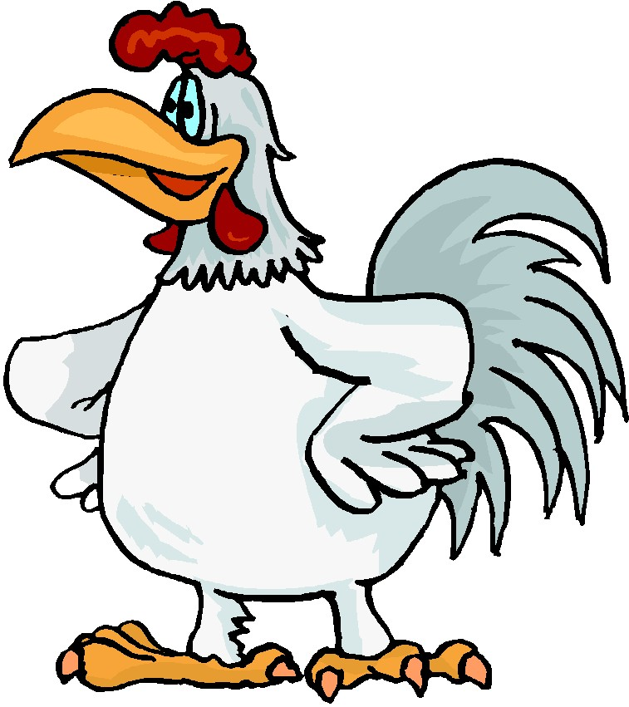
Blockchain Blockchain – Chicken
Chicken chicken chicken
Chicken chicken
Chicken chicken chicken blockchain!

Slide 6
Blockchain Blockchains
Blockchain-blockchain blockchain
Blockchain blockchain blockchain
Blockchain blockchain
Blockchain blockchain

Slide 7
Blockchain Blockchain – Blockchain
Blockchain blockchain
Blockchain
Blockchain
Blockchain blockchain blockchain blockchain

Slide 8
Blockchains – Blockchain
Blockchain blockchain
Blockchain!
Blockchain blockchain blockchain
Blockchain-blockchains blockchain
Blockchain blockchain blockchain blockchain
Blockchain blockchain blockchain (chicken)

Slide 9
Blockchain
Blockchain 👍
Blockchain 👍
Blockchain 👍

Slide 10
Chickens?

Slide 11
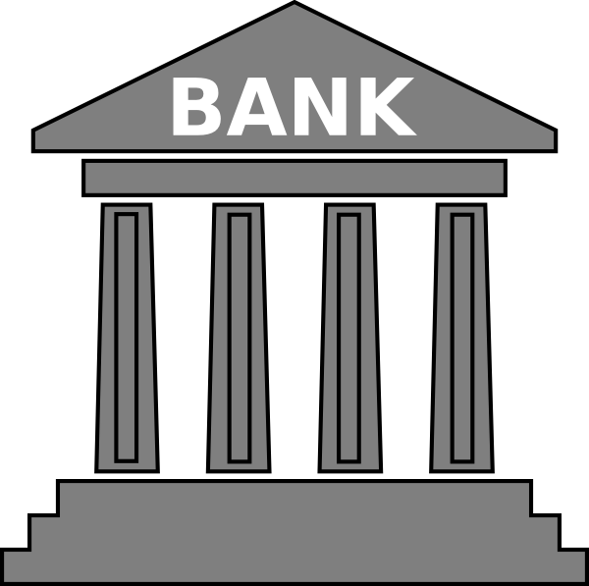
Leakage Leakage – Leakage
Leakage leakage!
$30
$10
Leakage leakage leakage
Alice | $50
Bob | $30
Charlie | $10
Alice
Alice
Leakage leakage leakage ☹

Slide 12
Leakage Leakage – Blockchain
Blockchain leakage
$10
Alice | $50
Bob | $30
Charlie | $10
Charlie
Blockchain blockchain blockchain
Blockchain blockchain (blockchain)
Alice
$10

